Slide 1
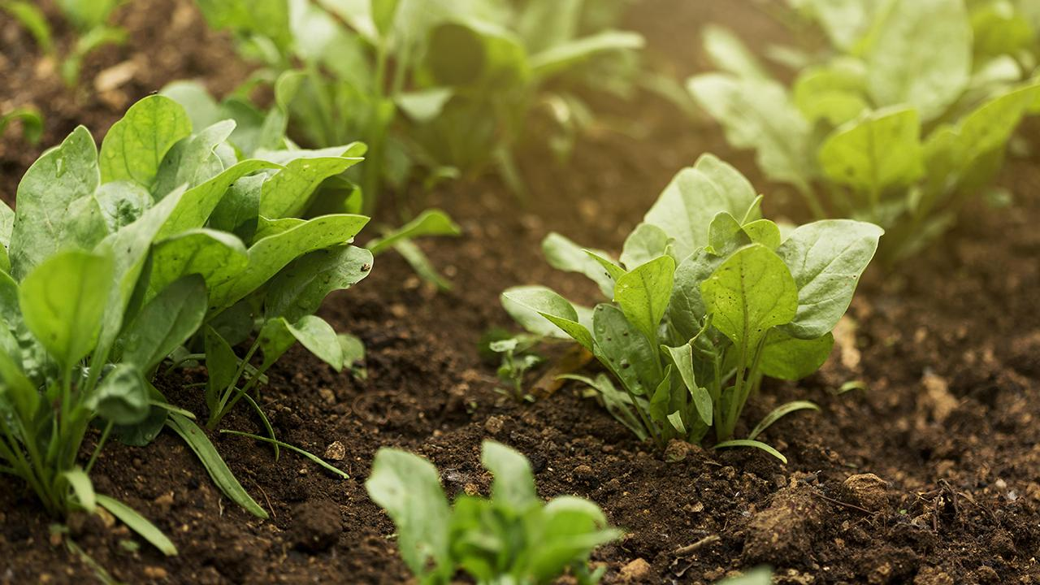
Federated Learning for Potato Leaf Disease Detection using CNN
Presented by-
Team no - 09
Rakib Hossain Rifat ID: 22366030
Marufa Kamal ID: 22366033
Abanti Chakraborty Shruti ID: 22366034
Ehsanur Rahman Rhythm
Md. Humaion Kabir Mehedi

Slide 2
Table of contents
Introduction
Proposed Method
01
04
Motivation
02
05
Challenges
Related Works
06
Conclusion
03

Slide 3
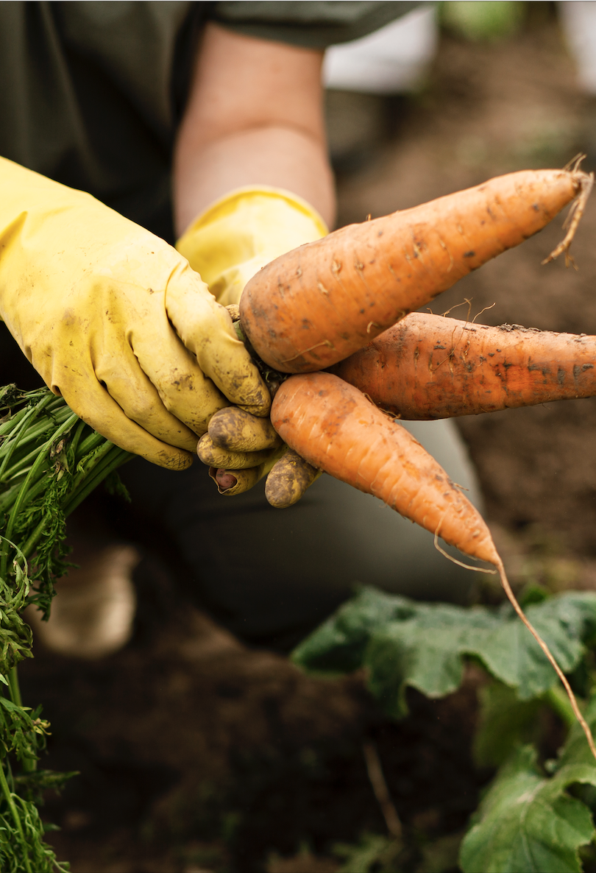
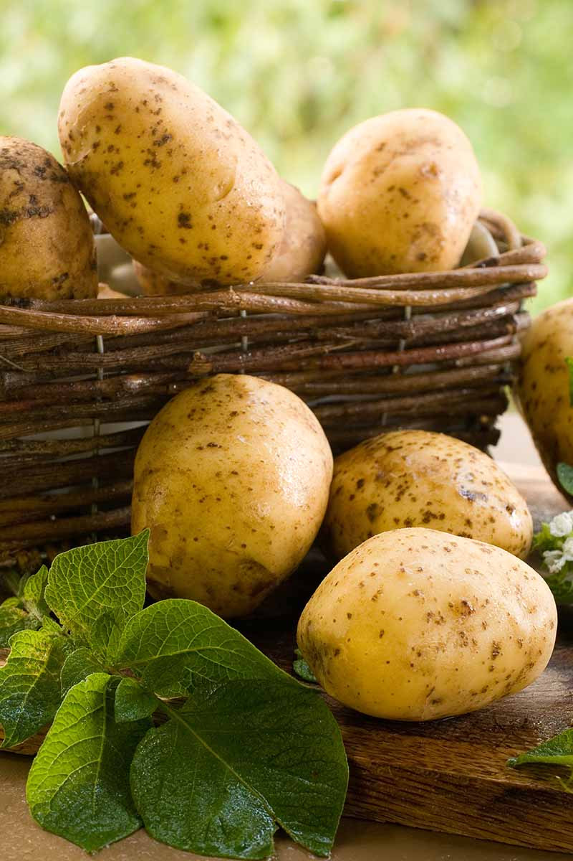
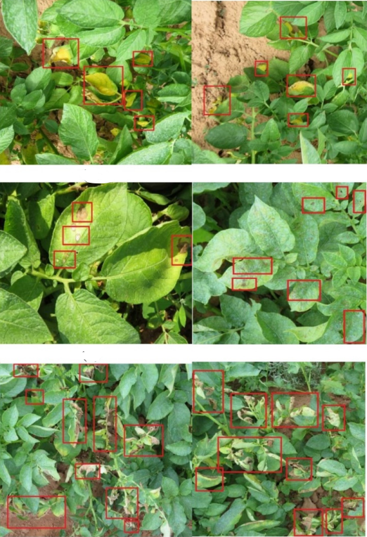
Introduction
Propose federated learning (FL) to detect potato leaf disease across two clients without sharing sensitive data between them
Each client will be trained with the CNN model and its different architectures using their own dataset in this approach
The models will be aggregated to create a global model and this global model is then used to detect potato leaf disease across multiple farms
Experiments will be conducted using different custom and pre-trained CNN architectures
As our dataset, 2 datasets collected from Bangladesh[1][2] and Pakistan[3] will be used

Slide 4
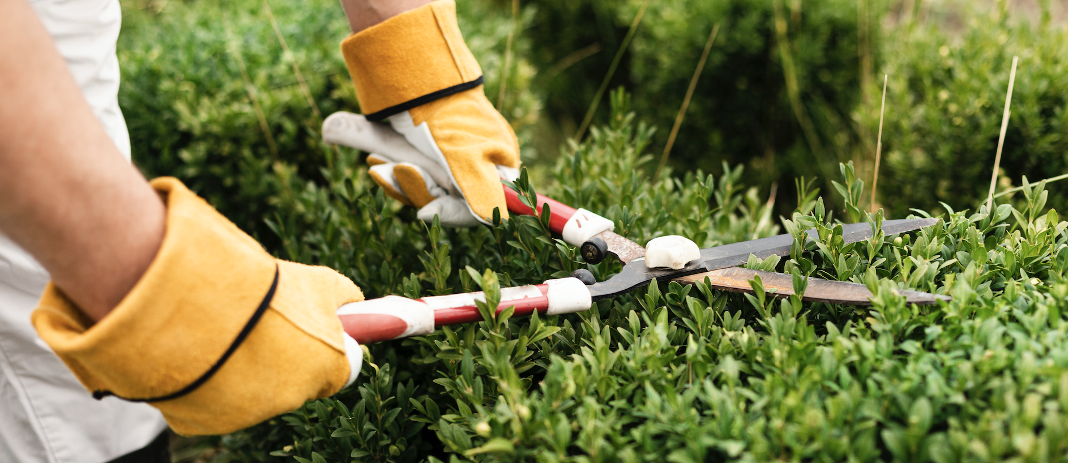
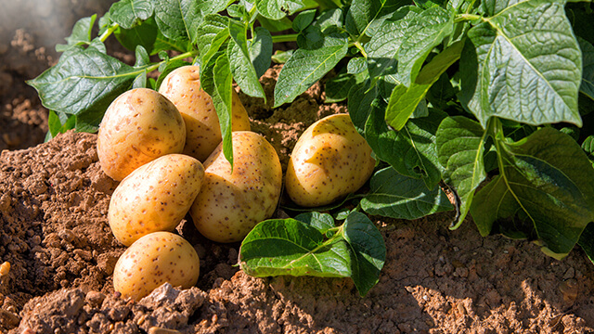

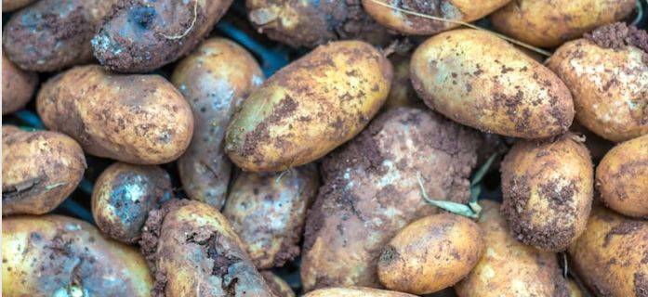
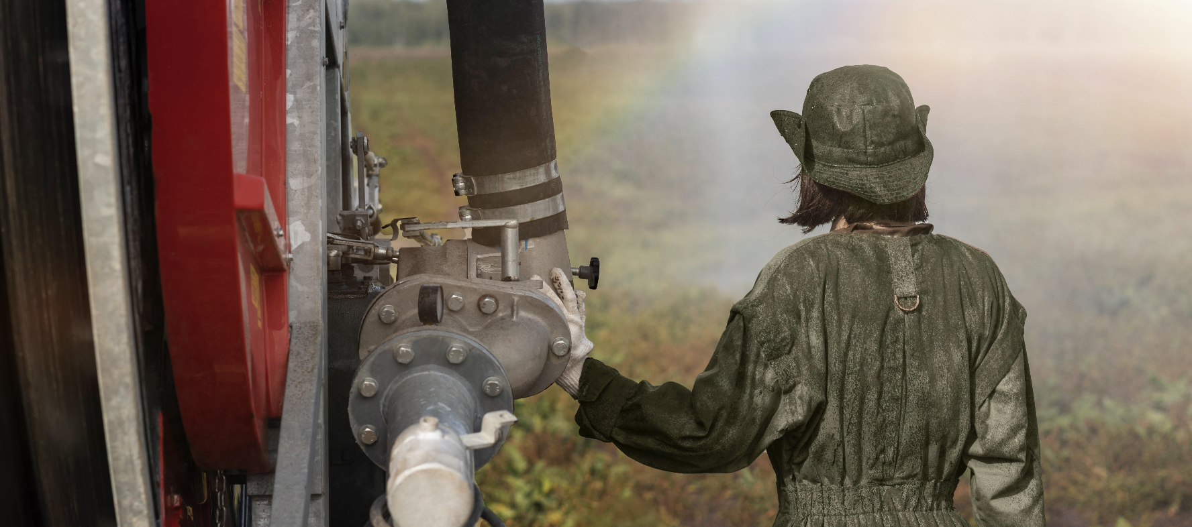
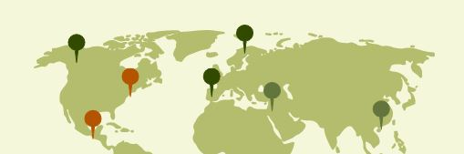
Motivation
Significance
Potatoes are the third-most significant food crop in the world for human consumption
Issues
Late identification of diseases is one of the prime reasons for damaged crops.
Privacy
Using FL allows multiple clients to maintain the confidentiality of their crops while creating a efficient system

Slide 5
Related Works
 | Year | Methods | Accuracy
Tiwari et al. [4] | 2020 | Feature selection -VGG19, VGG16, and InceptionV3 Classifiers - SVM, KNN, neural networks, and logistic regression | 97.8%
Iqbal et al. [5] | 2020 | Feature selection - global feature descriptors Classifiers - SVM, K-NN, LDA, Random Forest, Decision Tree, Naive Bayes | 97%
Agarwal et al. [6] | 2020 | CNN with 4 convolutional layer | 99.8%
Khalifa et al. [7] | 2021 | CNN with 14 layers | 98%
Afzaal et al. [8] | 2021 | GoogleNet, VGGNet, and EfficientNet | -

Slide 6
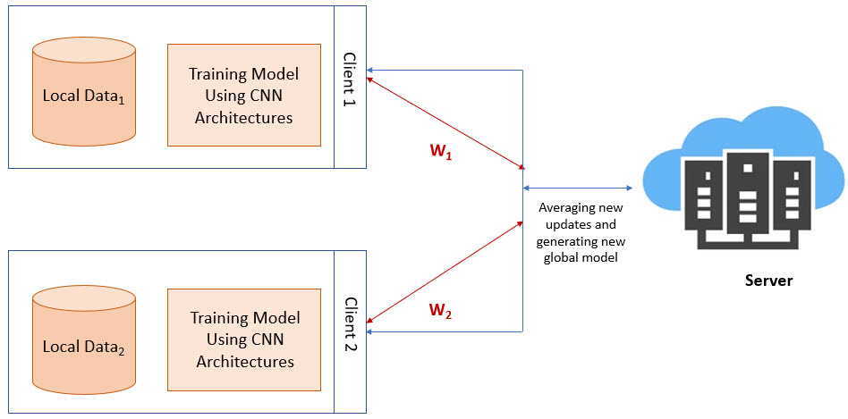
Proposed Method

Slide 7
Challenges
Custom CNN Model
Deciding the layer size and parameters
Dataset
Accurate Methods
Finding multiple relevant dataset
Deciding the classifiers to be used

Slide 8
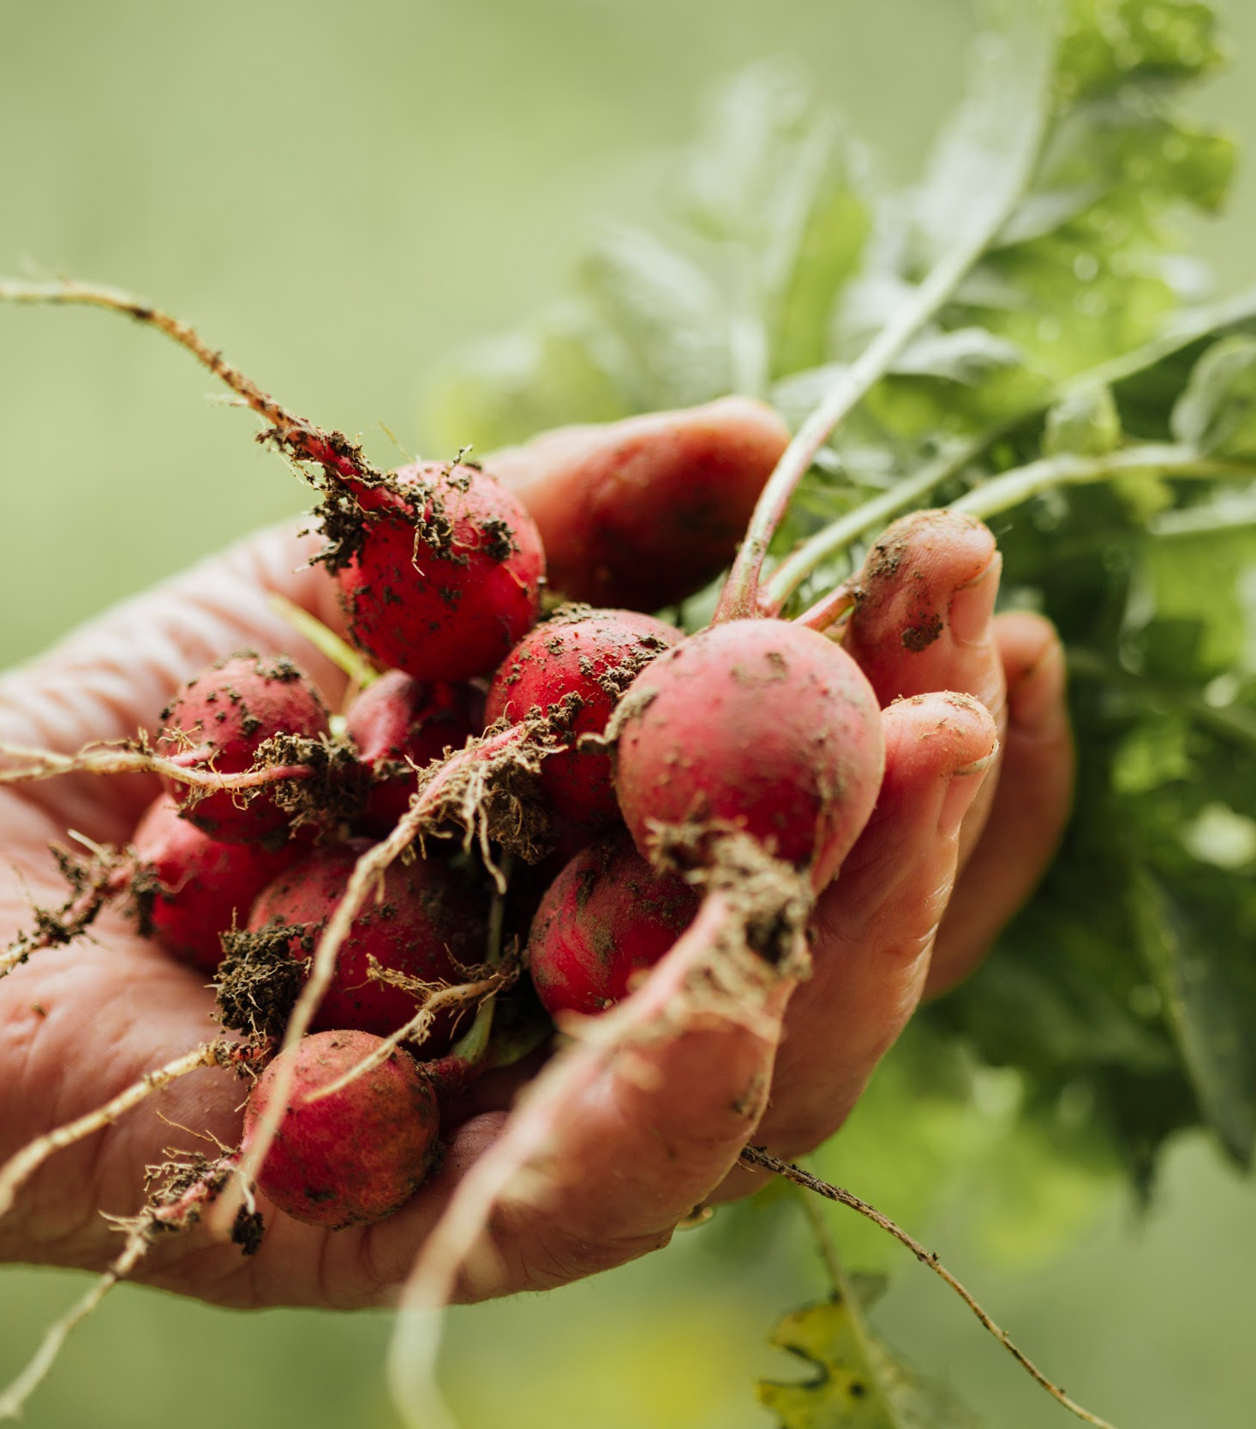
Conclusion
A federated learning-based framework is proposed in this research to identify the two most familiar diseases of potato leaves
This approach helps to maintain data privacy which is usually a concerning point in the agricultural sector.
Demonstrate the advantages of collaborating on multiple agricultural crops
Enables scalability to add more clients

Slide 9
References
[1] D. Hughes, M. Salathe´ et al., “An open access repository of images on plant health to enable the development of mobile disease diagnostics,” arXiv preprint arXiv:1511.08060, 2015.
[2] “New bangladeshi crop disease,” https://www.kaggle.com/datasets/ nafishamoin/new-bangladeshi-crop-disease.
[3] J. Rashid, I. Khan, G. Ali, S. H. Almotiri, M. A. AlGhamdi, and K. Masood, “Multi-level deep learning model for potato leaf disease recognition,” Electronics, vol. 10, no. 17, p. 2064, 2021
[4] D. Tiwari, M. Ashish, N. Gangwar, A. Sharma, S. Patel, and S. Bhardwaj, “Potato leaf diseases detection using deep learning,” in 2020 4th International Conference on Intelligent Computing and Control Systems (ICICCS). IEEE, 2020, pp. 461–466.
[5] M. A. Iqbal and K. H. Talukder, “Detection of potato disease using image segmentation and machine learning,” in 2020 International Conference on Wireless Communications Signal Processing and Networking (WiSPNET). IEEE, 2020, pp. 43–47.
[6] M. Agarwal, A. Sinha, S. K. Gupta, D. Mishra, and R. Mishra, “Potato crop disease classification using convolutional neural network,” in Smart Systems and IoT: Innovations in Computing: Proceeding of SSIC 2019. Springer, 2020, pp. 391–400
[7] N. E. M. Khalifa, M. H. N. Taha, L. M. Abou El-Maged, and A. E. Hassanien, “Artificial intelligence in potato leaf disease classification: a deep learning approach,” Machine Learning and Big Data Analytics Paradigms: Analysis, Applications and Challenges, pp. 63–79, 2021.
[8] Afzaal, H., Farooque, A.A., Schumann, A.W., Hussain, N., McKenzie-Gopsill, A., Esau, T., Abbas, F. and Acharya, B., 2021. Detection of a potato disease (early blight) using artificial intelligence. Remote Sensing, 13(3), p.411.

